Slide 1
Making Informed, Cost Saving Travel Decisions and SmartPay Essentials Jennifer Burdette

Slide 2
GSA Mission, Vision, Values
Mission: To deliver the best customer experience and value in real estate, acquisition, and technology services to the government and the American people.
Vision: Effective and efficient government for the American people
Values: Service, Accountability, and Innovation

Slide 3

What are GSA’s Travel Programs?
Booking: E-Gov Travel Services (ETS2)
As a note, DoD uses Defense Travel System (DTS) and/or MyTravel to book
Air: City Pair Program (CPP)
Rideshare: Government-wide Rideshare/Ride-Hail
Lodging:
FedRooms® for Temporary Duty Travel: 1-29 night(s)
Long Term Lodging: 30+ nights
Emergency Lodging Services: Lodging for planned and unplanned events

Slide 4
How do GSA’s Travel Programs Benefit Me and My Agency?
GSA Travel Programs’ Goal: Provide agencies with programs and services that are efficient and effective to manage travel
The Government-wide Travel Category has 5 Best-In-Class (BIC) Solutions: City Pair Program, TDY Lodging, Emergency Lodging Services, Car Rental, and Employee Relocation Homesales
Supports Government-wide Category Management Goals, specifically Spend Under Management and Cost Avoidance
SmartPay® provides uniform forms of payment for purchase of travel services

Slide 5
Smart Travel Planning
We are going to follow a Federal traveler who uses GSA’s Travel Programs to complete their mission
We will highlight the benefits using GSA’s Travel Programs
Let’s meet our Federal traveler!

Slide 6


Smart Travel Planning with Rob
Rob is a GS-13, Contracting Officer for the Department of Transportation
Let’s follow Rob as he prepares for a trip to his Regional Office in New York

Slide 7
Rob Uses E-Gov Travel Services (ETS2)
ETS2 is an end-to-end web based Travel and Expense solution that provides travelers with a one stop shop including:
Online reservations for air, rail, lodging and rental car
Travel Management Center (TMC) support when necessary
Authorization for TDY travel
Voucher and expense processing upon completion of TDY travel
Quick reimbursement of approved expenses
ETS2 Vendors
CWTSato Travel (E2 Solutions)
SAP Concur (ConcurGov)

Slide 8
ETS2 Benefits for Rob
Simple: Book all travel needs (air, hotel, rental car, rail) at once
Cost savings: Travelers save approximately $25 per transaction when completed online vice agent assisted
Federal Travel Regulation (FTR) compliance: Government specific configurations ensures travelers are compliant with agency policy
Quick Reimbursement: ~4 days

Slide 9

Rob Books GSA’s FY23 City Pair Program (CPP) for his Flights
CPP provides discounted air transportation services for Federal travelers government-wide
8 Contract Carriers
12,139 markets in FY23 (9,422 Domestic and 2,717 International)
Over 2,000 awarded markets with non-stop service, where available

Slide 10
CPP Benefits to Rob
Fully refundable tickets
No advance purchase required
No change fees or cancellation penalties
Stable prices which enables accurate travel budgeting
No blackout dates
Fares priced on one-way routes, permitting agencies to plan multiple destinations
May use loyalty membership to get points/miles for redemption on personally expensed upgrades, airfare, and ancillary fees

Slide 11
Rob Should Choose the _CA Fare
Deeply discounted fare code is called _CA (“Dash CA”)
Airlines control inventory of _CA fares & availability is limited
Available in 92.5% of markets
Example: Washington (DCA) to NYC (JFK) on Delta Air Lines
Book and approve travel early to take advantage of _CA fares!
YCA Fare Each Way | _CA Fare Each Way | Savings by Using _CA Fare Each Way
$165 | $107 | $58

Slide 12
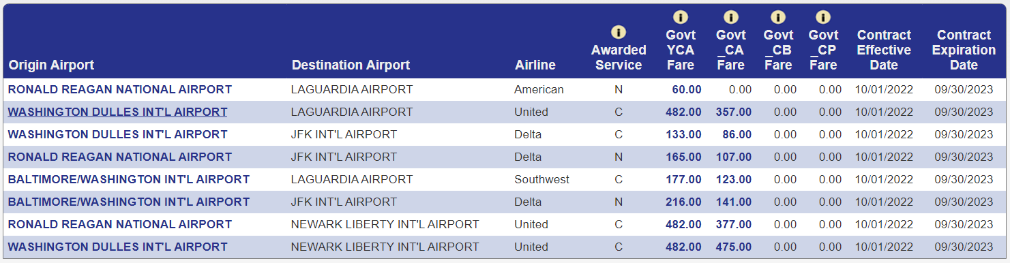
Rob Should Consider Alternate Airports
Alternate airports may have lower fares - weigh the pros and cons

Slide 13
Rob Books the FedRooms® Rate Enjoys Benefits and Protections At or Below Per Diem
FedRooms® provides hotel accommodations at or below per diem to government travelers on official business with standard amenities like:
4pm day of arrival cancellation policy (in U.S.) and 24 hour cancellation policy for international No hidden service or resort fees No early check-out fees | No minimum stay requirements Complimentary guest room Wi-Fi Americans with Disabilities Act (ADA) and FEMA certified Earn brand loyalty points

Slide 14
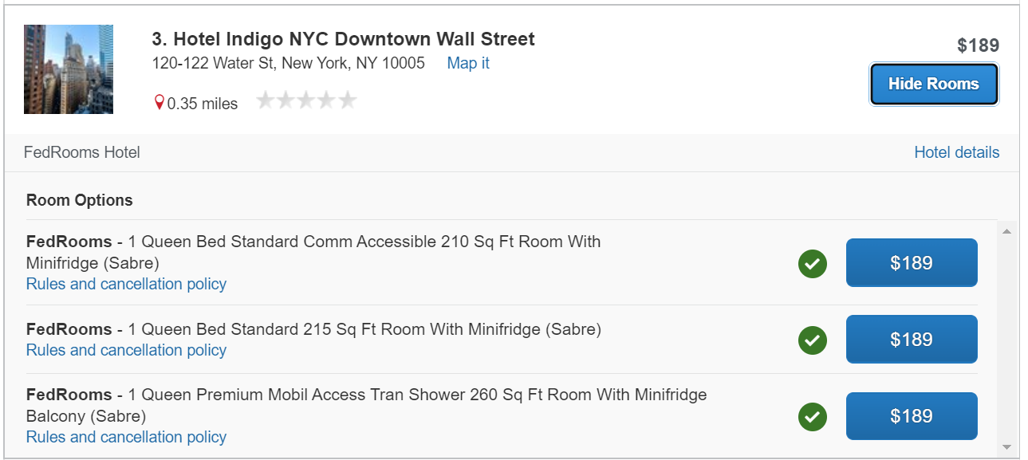
How Rob Books a FedRooms® Rate in ETS2
Select a FedRooms® property from the search results in your ETS2 booking tool
Click “View Rooms” and select a “FedRooms” rate, clearly labeled with a green check mark, indicating it is within policy

Slide 15







FedRooms® Has You Covered Globally!
In 2023, 10,000+ properties in 2,700+ markets
Some of our participating hotels chains:

Slide 16
BUYER BEWARE!:
The FedRooms® Rate is NOT the GOV Rate
The FedRooms® Rate is negotiated by the Federal Government, providing you protections and amenities you won’t get by booking another rate, like a GOV rate.
GOV Rate
Rates are determined by individual hotels
May or may not meet per diem
Hidden charges may apply, like: Resort or destination fees 1-5 day cancellation fees
FedRooms®
Rates are negotiated by the Federal Government
Always at or below per diem
No hidden fees

Slide 17
One Last Solution for Rob’s Longer Stays
Long Term Lodging (LTL)
30+ nights
For individuals or groups
Fully furnished, serviced apartments with the comforts of home
Many with added amenities
Available under the GSA MAS, Category L – Travel, L02\ Lodging, SIN 531110
Ideal for:
Long term TDY Extended training and job assignments | Rotational assignments at agency regional offices Relocation

Slide 18

Benefits of Long Term Lodging (LTL) for Rob
Provides easy access to pre-qualified suppliers to help support federal agency travel management needs
Streamlines the acquisition process by using GSA contracts
For buys under $10K Traveler can purchase directly with Travel card
Schedules rates are ceiling prices
Deeper discounts can be negotiated at the task order level

Slide 19
What if Rob Needs Lodging for an Emergency?
Emergency Lodging Services (ELS) - A Best-In-Class (BIC) Lodging Solution
Lodging for emergency situations or for planned emergency related events (ex: National Guard Drill Weekends)
For individuals or groups
Hotels/Motels/Apartments
Ancillary services can be provided: Food, Laundry, Meeting Space, Airport Shuttle Service
BPA Available under the GSA MAS, Category L – Travel, L02\ Lodging, SIN 561599
Ideal for:
Natural or Manmade Disasters Emergency related training Displaced disaster/emergency victims Refugee resettlement missions | COOP Events National Special Security Events Pandemic mission related events Relief/Emergency support personnel

Slide 20
Government-wide Rideshare/Ride-hail
GSA awarded the Government-wide Rideshare/Ride-hail Blanket Purchase Agreements (BPAs) to Lyft and Uber with a Period of Performance of five years
Coverage: top 50 domestic markets
Agency Benefits
Full commercial capability managed by GSA Up front pricing Negotiated discounts Traceable transactions | Data tracking to inform smart travel decisions Streamlined procurement process Additional rebates via SmartPay® travel card

Slide 21
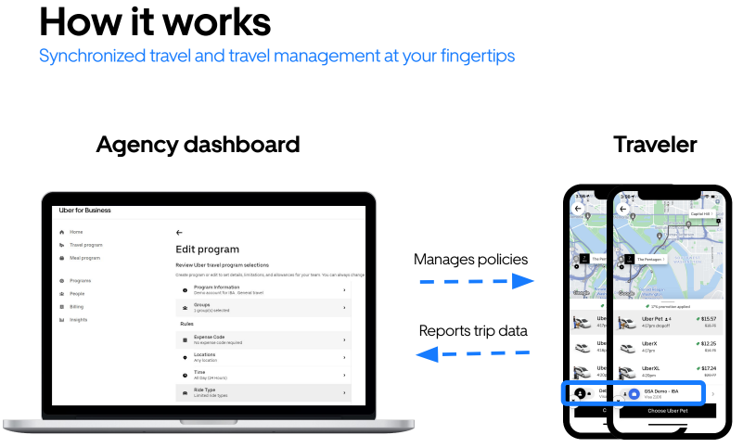
Government-wide Rideshare/Ride-hail
Program in action: Agency Dashboards will strengthen compliance, streamline travel management, and offer robust data reporting
Set parameters/Govern profile options
Set program funding sources
Prompt safeguards for accurate profile
booking
Dedicated Account Managers

Slide 22
U.S. Government Rental Car Solution
Defense Travel Management Office (DTMO) operates a government-wide car rental program that negotiates government discounts.
Travelers must use the least expensive compact car available, unless an exception for another class of vehicle is approved (FTR 301-10.450)
Agency Benefits
Unlimited mileage (except one-way)
No minimum rental period (except one-way)
No additional cost for Loss Damage Waiver (LDW)/Collision Damage Waiver (CDW)
Liability insurance coverage
No additional fees for additional authorized drivers or drivers under the age of 25

Slide 23

Government Savings – Rob’s Trip (DC to NY)
Trip Cost Category | Maximum Trip Costs | Minimum Trip Costs | Potential Savings over 3 Nights
Airfare (round-trip) | $330 YCA fare | $214 _CA fare | $116 using _CA fare
Lodging (3 nights) | $774 ($258 per night) per diem | $567 ($189 per night) FedRooms® | $207 using FedRooms®
Transportation (3 days) | $223.41 car rental | $133.82* rideshare | $89.59 using rideshare
Total | $1,327.41 | $914.82 | $412.59
*estimate only, assuming 2 rides during trip

Slide 24
Thank you!
GSA Travel Program | Point of Contact
E-Gov Travel Service | michael.cooley@gsa.gov
City Pair Program | jennifer.burdette@gsa.gov
FedRooms® | jennifer.miller@gsa.gov
Long Term Lodging | trevor.edwards@gsa.gov
Emergency Lodging | marcus.witowski@gsa.gov
Rideshare | lamarr.peppers@gsa.gov

Slide 25

GSA Starmark Logo

